Slide 1
Simple Expense Tracker Application
Expense tracking and analytics application
Built using Java & Spring Boot
In-memory data storage (no database)

Slide 2
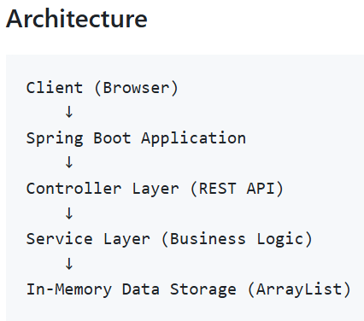
Design & Architecture
Lightweight Spring Boot application
  Main Application
  Controller
  Service
  Data
REST-based backend
Simple HTML frontend
Notes:
The application follows a clean layered architecture. A simple HTML interface communicates with a Spring Boot REST API. The controller layer handles requests, the service layer contains the business logic, and all expense data is stored in memory using an ArrayList. This keeps the design simple and easy to extend.

Slide 3
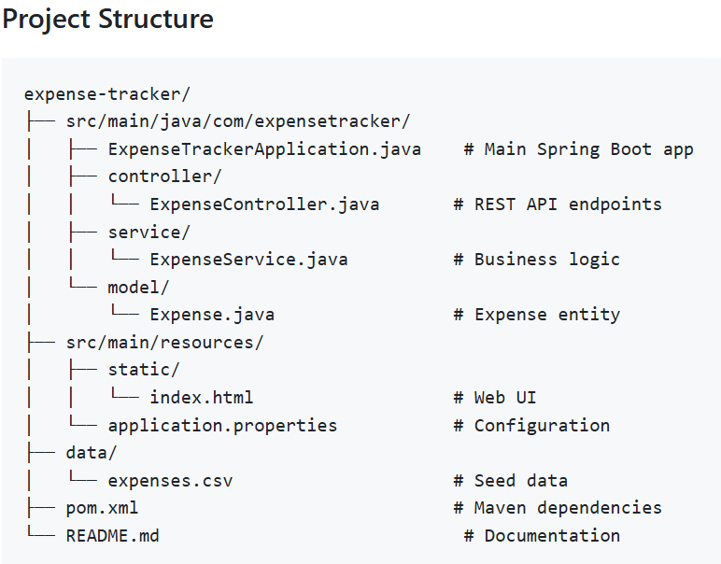
Key Files
ExpenseTrackerApplication.java: Main Spring Boot application class, Entry point that starts the server
ExpenseService.java: Core business logic, CRUD operations for expenses, Statistics calculations (total, by category, highest/lowest), Seed data loading
Expense.java: Data model with fields: id, category, amount, date, description
Index.html: Simple HTML form for adding expenses, Table displaying all expenses, Statistics display, Edit and delete functionality
ExpenseController.java: REST API endpoints:
POST /api/expenses - Add expense,
GET /api/expenses - Get all expenses,
GET /api/expenses/{id} - Get expense by ID,
PUT /api/expenses/{id} - Update expense,
DELETE /api/expenses/{id} - Delete expense,
GET /api/stats - Get statistics
Notes:
The codebase is organized by responsibility. The controller exposes REST endpoints such as POST to add an expense, GET to retrieve all expense or a specific one by id, PUT to update an existing expense, and DELETE to delete an expense, the service layer handles calculations and data management to display trends such as highest and lowest spending categories, and the model represents an expense. The frontend is a simple static HTML file, and sample data is provided through a CSV file.

Slide 4
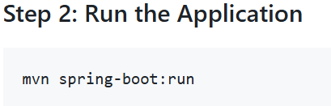
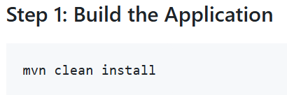
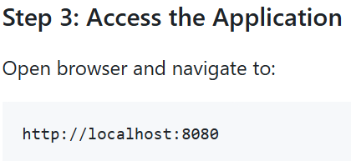
Process to Run, Test, and Verify
Prerequisite
Java 17 or higher
Maven 3.6 or higher
Step 1
Step 2
Step 3
Notes:
The application can be built and run using Maven. Once started, the UI is available on localhost. Functionality was verified by adding, editing, and deleting expenses and confirming that all statistics update correctly. API endpoints can also be tested directly using tools like curl or Postman.

Slide 5
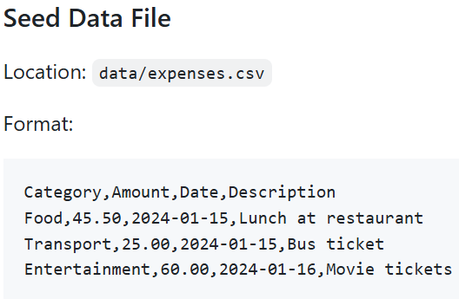
Test Data and Seed Data
Seed data is automatically loaded when the application starts
Data is read from data/expenses.csv file
If file doesn't exist, application starts with empty expense list
Seed data is parsed and added to in-memory storage
Notes:
To make testing easier and to demonstrate the application’s functionality right away, I added support for seed data. When the application starts, it automatically looks for a CSV file located at data/expenses.csv. If the file exists, the application parses each record and loads the expenses into memory. If the file doesn’t exist, the application simply starts with an empty expense list without failing. Once the app is shut down, the RAM will be cleared, and so I did consider saving any new record to the expenses.csv, but I realized that would pose a security risk since anyone could add, modify, or delete expenses, and a malicious user could alter totals or statistics, thus leading to compromised business data integrity.

Slide 6
Thank you!

